Slide 1







X
Business
Intelligence Analyst
Virtual Internship Experience
By Arini Arumsari

Slide 2

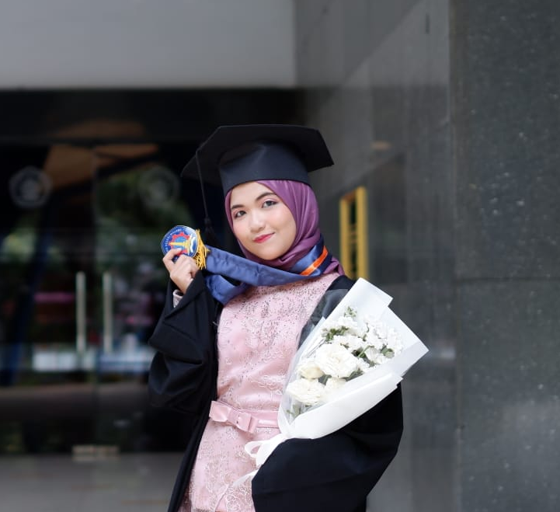
About Me
Graduate from State Polytechnic of Malang, Recently I join bootcamp at Rakamin Academy majoring Data Scientist for six month, I have experience internship virtual from Rakamin Academy X PT. Bank Muamalat as a Business Intelligence Analyst.
Arini Arumsari

Slide 3

Portfolio
BIKE SHARING DATASET
VEHICLE INSURANCE
This project aims to analyze the data in the Bike Sharing Dataset. The ultimate goal is to generate useful insights and information from the analyzed data. link
The company aims to predict customer interest from existing health insurance policyholder data. To do this, a model is needed that can assist the process. link

Slide 4
Flow Chart
Start
Create ERD Diagram
Create Master Table
answer by query
Dashboard
End

Slide 5
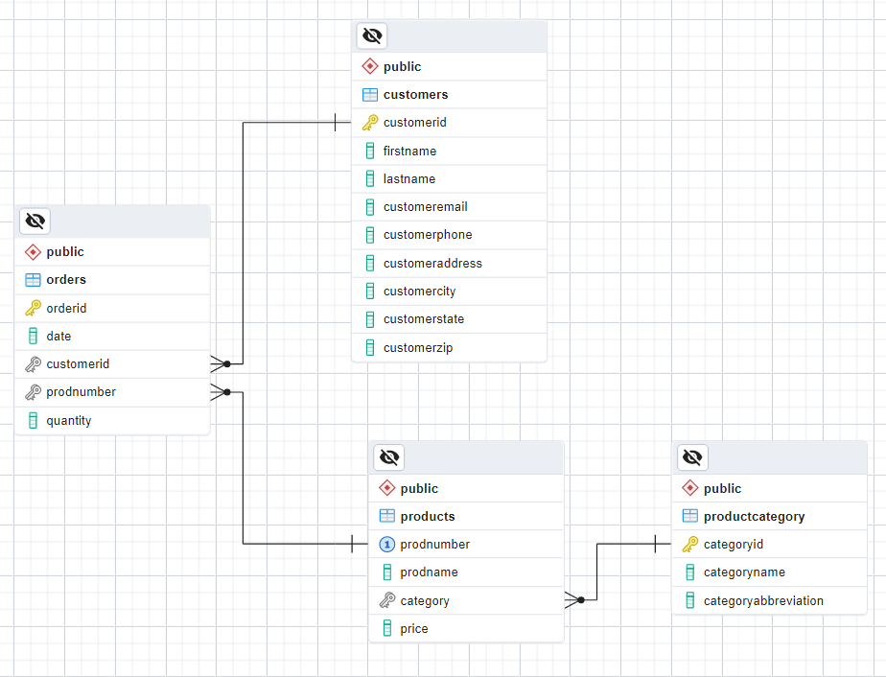
Create ERD Diagram

Slide 6
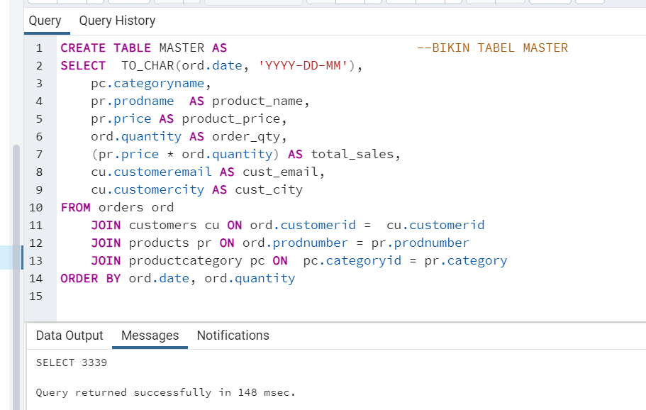
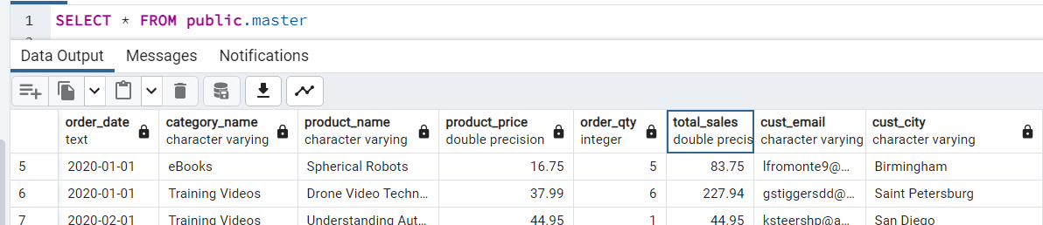
Create Master Table
Welcome
Presentation are communication tools that can be used as demontrations, lectures, reports, and more. it is mostly presented before an audience.
@reallygreatsite

Slide 7
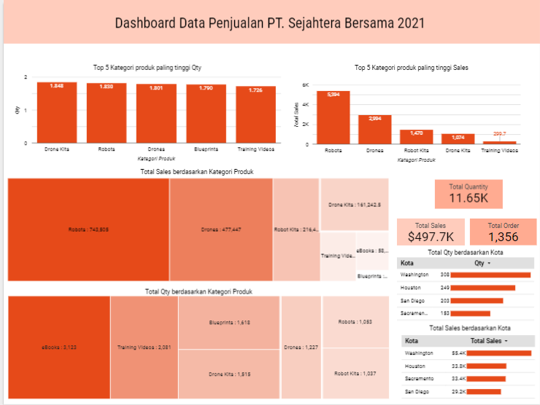
Dashboard
Link Dashboard

Slide 8
Conclusion
Conclusion 1
Conclusion 2
The number of Robot Kits Product Categories has been increased because, based on sales data, the Robot Kits Product Category has entered the top 5 sales. This means that interest in the Robot Kits Product Category is greater than interest in the Blueprints Product Category.
Based on the top 5 sales chart, the Robot Product Category has the highest sales compared to the others. It would be better if we added more Robot Product Categories.

Slide 9




Contact
GitHub
LinkedIn
Looker Studio
link
link
link
ariniarum98@gmail.com

Slide 10


